Slide 1
Example of First Day of School Presentation
I gave some version of this presentation on the first day of school.
I varied it based on the class, age group, and other factors so that it was appropriate for its audience.
Download for free at: https://bryanholmesauthor.wordpress.com/resources-services/

Slide 2
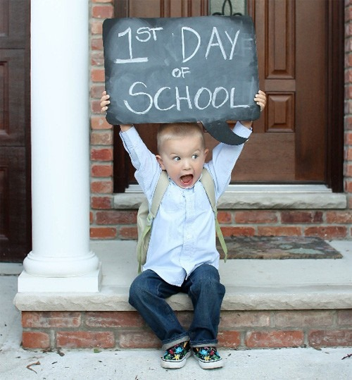
Welcome to
8th Grade Science!
Mr. Holmes, Room 205

Slide 3
Lesson Overview
LEARNING TARGET: I can learn about my science class and how it will work.
OVERVIEW: Today is an introduction to me and how I plan to conduct our class, and a chance for you to introduce yourself to me.
We will do some other introductory activities for the rest of this week and next week, and we will start our first science unit next Friday.

Slide 4
Introduction to Mr. Holmes
16th year teaching STEM subjects.
Experience teaching at three high schools and one middle school.
Retired Air Force Lieutenant Colonel and experienced pilot and flight instructor.
Husband and father with 3 children.
Interests: Hiking, biking, skating, xc skiing, running, gardening, reading, maple syrup making.

Slide 5
Introduction to Mr. Holmes
College experience:
  UNC Chapel Hill (traditional college in residence, 1980 - 1984)
  Central Michigan University (extension program degree, 1995 - 1997)
  Southern Connecticut State University (night school degree, 2008 - 2010)
  Fort Hays State University (online degree, 2010 - 2012)
I can share a lot of different college experiences if you have questions.

Slide 6
Basic Rules & Procedures
My basic rules for this class:
    Be ready for class
    Be responsible
    Be respectful
You will have a chance to write a class charter during the next class.
My intent is to treat you like young adults who are preparing for high school.

Slide 7
Crews
You are each sitting at a table with a “crew.”
A crew is more than just a group – think of a ship’s crew, and airplane crew, or a space station crew – what do they all have in common?
You will do most activities with your crew, but you will be responsible for your own work – so don’t be a snowman!

Slide 8
Meet Your Crew
Take turns and have each person explain what they did this summer, or share something special about themselves.
  You each have up to 2 minutes.
  You may volunteer to share your information with the class after we finish.

Slide 9
Classroom Tour
Let’s walk around the room and talk about what you see and why things are here.
Please do not open any cabinets or drawers or touch anything right now – everything needs to stay clean for when we need it.

Slide 10
Google Classroom Tour
You all have been invited to join this class’ Google Classroom – make sure you join and can access it – let me know if you have any questions or issues.
Let’s look at it to see how it’s set up.

Slide 11
Closing
What final questions do you have?
Homework (not graded) – Post the following as a private comment for today’s assignment in Google Classroom:
  3 things you want me to know about you.
  2 questions you have about the class.
  1 other comment or question about our class.

