Slide 1
Example of Lab Assignment
The following lab assignment was the first lab I gave in physics and in 8th grade science if we covered physical science.
The purpose of this lab, along with teaching students about average speed, was to teach them how to set up and conduct a scientific experiment, the NGSS Science Practices skill.
  Because it was the first lab done by students, it is more scripted, but later labs gave students more leeway to plan the experiment.
Download for free at: https://bryanholmesauthor.wordpress.com/resources-services/

Slide 2
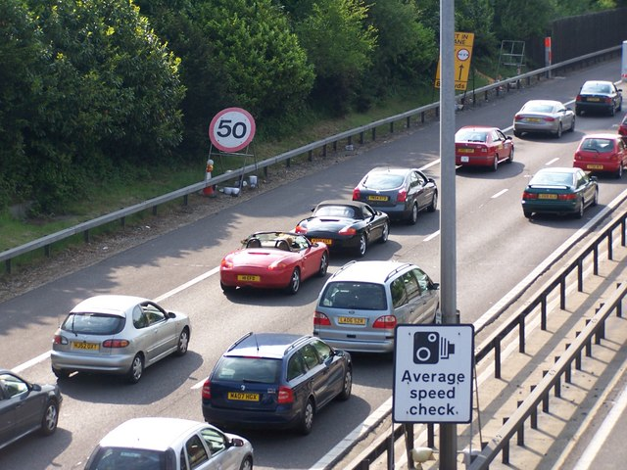
Lab – Average Speed
Mr. Holmes, 8th Grade Science

Slide 3
Lesson Overview
Learning Target: I can observe, measure, analyze, and calculate average speed.
Directions: We will go through these slides in class to learn how to do a lab experiment where each crew will observe and measure the average speeds of one of your members as he/she walks down the hallway. You will also graph the data and calculate the average speeds. You will document all of your work in an individual lab report that is attached in Google Classroom. This lesson counts as a Lab and will be graded with the rubric posted with the lesson.
Safety: There is nothing hazardous in the experiment, but do not horse around in the hallway, as someone could get hurt that way.

Slide 4
Preliminary Questions
Scenario: A person walks across the floor in one direction.
  How would you measure the person’s distance? displacement?
  How would you measure the person’s average speed?
Answer these questions now with your crew, and be prepared to discuss your answers - you must be able to answer these questions to do the lab.

Slide 5
Lab Instructions
SUMMARY: To do this lab experiment, you will be comparing the average speeds of two different people in your crew.
  You will pick two people in your crew to be walkers and have them walk in a straight line for five seconds in the hallway outside our classroom. Have one person walk slowly, while the other walks faster.
  Measure the distance walked in meters for each person.
  When you calculate the average speeds, use meters/second as the units of speed.
STEP BY STEP INSTRUCTIONS:
  Open the lab report Google Doc in the assignment in Google Classroom.
  Talk with your crew to determine the purpose, question or hypothesis, then write these down.
  Discuss the experiment’s steps, then write up the Setup and Procedure, and make a data table to collecting the distance and time for each walker.
  Assign roles: 2 walkers, 1 timer, 2 distance measurers (some people will have more than one role).
  Go in the hallway and collect your data. Afterwards, make sure everyone in your crew has a chance to fill in their data table.
  Open a Google Sheets spreadsheet, copy your data table into the spreadsheet, then make a graph for each walker’s distance vs. time, then copy and paste both graphs into your lab report. Ask me for help if needed.
  Calculate the average speed of each walker.
  Document the final exercise we do in class, then discuss everything with your crew and write the Conclusion in the lab report.

Slide 6
Closing
What did you learn in this lab?
Homework: Finish your lab report tonight if you did not finish it in class.

