Slide 1
Example of a Presentation to Teach a Skill Early in School Year
The following presentation was one I gave during the first week of school to teach students the engineering design process, one of the skills in the NGSS.
  Subsequently, I gave students an engineering design project where they used this skill about once per month, and beginning with the second project, I required them to document their work in an engineering design project report.
Because students often had not done an engineering design project like this before, this project was a simple introduction to the engineering design process with no requirement to document their work in a report.
Download for free at: https://bryanholmesauthor.wordpress.com/resources-services/

Slide 2
Introduction to NASA’s Engineering Design Process
How to Solve Problems
Like an Engineer
Mr. Holmes
8th Grade Science

Slide 3
Lesson Overview
Learning Target: I can learn and apply the NASA engineering design process.
Directions: This lesson introduces an engineering design process provided by NASA, then gives you a chance to apply it in a quick design challenge you will do with your crew. Your assignment is to work with your crew and do your best on the design challenge. The assignment counts as Classwork and will be graded based on the teamwork and performance of your crew.
For students at home, please read through the slides and take notes on the NASA engineering design process, but you do not have to do the design challenge. There is nothing to submit for this assignment for you.

Slide 4
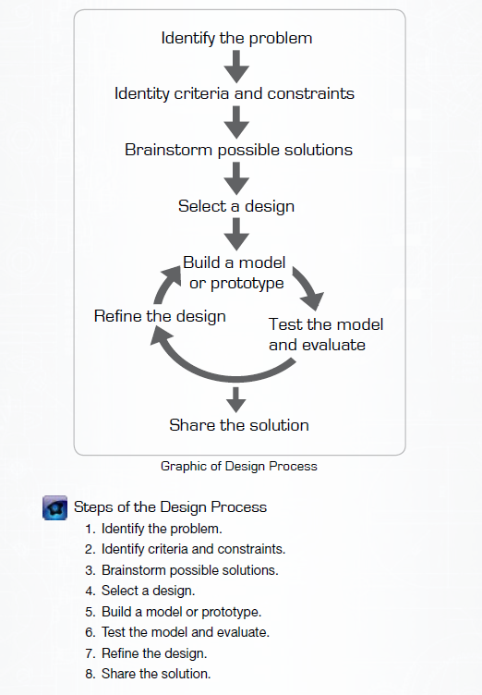
NASA’s Engineering Design Process
NOTE: I added “Research” to the early part of the process, as good engineers will research what has already been done by other engineers and inventors before they start brainstorming.
Research

Slide 5
Identify the Problem
Whose problem is it?
Do you understand it?
“Identify criteria and constraints” means…?

Slide 6
Research
Has someone else solved this problem before?
  What did they do?
  Can you use what they did?
Do you need to research more about the problem to understand it better?
Use the same research rules you have learned in other classes.

Slide 7
Brainstorm Possible Solutions
Everyone contribute – no judging ideas…yet.
Use SCAMPER to find new ways to use something:
  Substitute
  Combine
  Adapt
  Modify
  Put to another use
  Eliminate
  Reverse

Slide 8
Select a Design
Put ideas together from Brainstorming and Research.
Agree to the final design, then …

Slide 9
Build, Test, Refine …Until Your Design Solves the Problem

Slide 10
Share the Solution
Once you have a solution, tell people about it.
Follow the same principles for giving a good presentation that you have learned in other classes.

Slide 11
Questions?

Slide 12
Crew Exercise - Design Brief
Problem: We need to see how high we can build a tower with the fewest resources.
Solution: Your crew will design and build the tallest model tower you can with limited resources.
Criteria and Constraints:
  Your tower may be made with 4 sheets of paper and 20 centimeters of tape, but no other resources.
  You may cut the paper or tape any way you wish.
  You will have to follow the time limits and schedule given.
  Your tower must stand by itself with no outside help or tape holding it to the table.
  You do not need to take any notes or write a report - just use the white board to brainstorm and sketch a design.
  Your goal is to make the tallest tower!

Slide 13
Crew Exercise - Schedule
Follow this schedule to produce your tower.
  The schedule is meant to help you develop the best possible design before you try to build it.
Research & Brainstorming 5 minutes
Sketch a design on whiteboard 3 minutes
Build your tower, test it, refine it 15 minutes
Final presentation of your design 2 minutes
The teacher will announce the times you can start and stop each activity.

Slide 14
Closing
How does the engineering design process you learned compare to the scientific method that a scientist follows?
Homework: None, but be sure to post that you reviewed the Safety Contract with a parent/guardian, if not done already.

