Slide 1
Example of Engineeering Design Project Assignment
This is a classic engineering design project where students design, build, test, and refine something, in this case a simple, air launched paper rocket.
  The launcher uses an empty 2-liter plastic bottle connected to two 3-foot PVC pipes (3/4-inch) that are connected using a 90-degree joint.
  The rocket is a piece of paper fitted to slide over the end of the PVC pipe so that when a student steps on the bottle, a blast of air launches the rocket.
Download for free at: https://bryanholmesauthor.wordpress.com/resources-services/

Slide 2
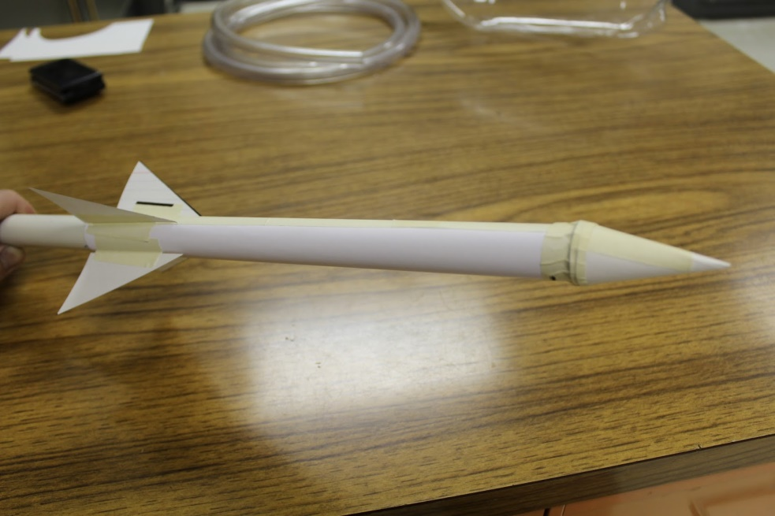
Engineering Design Project
Using Paper Rockets to Understand the Force of Gravity
8th Grade Science
Mr. Holmes

Slide 3
Lesson Overview
Learning Target: I can design and test launch a paper rocket that minimizes the forces of gravity and drag.
Directions: This is a engineering design project (EDP) that focuses on the force of gravity, then explores how gravity affects the motion of an object flying through the air, only under the effect of gravity. Take notes during the mini-lecture at the start, then follow the directions for the EDP. Document your lab work in the lab report provided in Google Classroom.

Slide 4
What is gravity?
Watch the video at: https://www.britannica.com/video/152179/Isaac-Newton-formulation-law-gravitation
How did Newton explain the force of gravity?

Slide 5
Newton’s Law of Gravitational Force
Newton’s theory was that gravity was a force that was proportional to the mass of each object being pulled toward each other.
This gravitational force would also get weaker the farther apart the objects were.

Slide 6
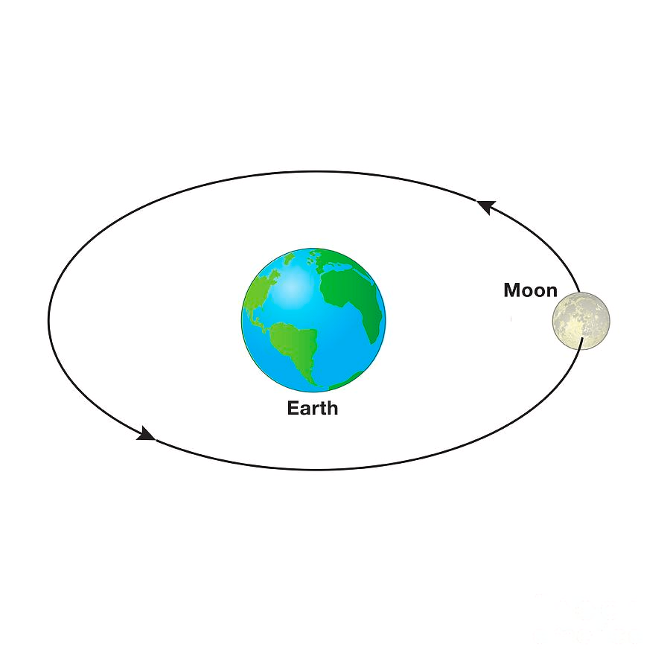
The Effect of the Force of Gravity on Moving Objects
The Moon is pulled by the Earth’s force of gravity and follows a circular path, called an orbit.
All objects in orbit had to begin with an orbital speed, or else they would just crash into the central object pulling them.
  How do you think the Moon got its orbital speed?
The Moon is pulled around in a circle by a gravitational force that is proportional to the mass of the Earth and the mass of the Moon.

Slide 7
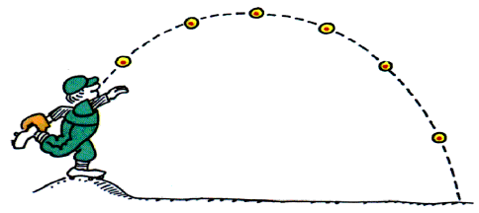
The Effect of the Force of Gravity on Moving Objects
Projectiles can also affected by drag, depending on their shape and density.
On Earth, any object thrown into the air, such as a baseball, is called a projectile.
  Projectiles are pulled by the force of gravity as they fly through the air.
The path of a projectile is called a trajectory.
  What makes a baseball go farther, or have a longer trajectory?
A baseball thrown upward will fall back downward, following a curved trajectory.

Slide 8
DIRECTIONS FOR THE
Engineering Design Project
First watch the demonstration of how to build and launch a paper rocket.

Slide 9
Engineering Design Project (EDP) Directions
DESIGN BRIEF:
Problem: In disaster areas, responders need a quick, easy way to send messages and papers, such as medical papers, across rivers or no go areas.
Solution: Each crew will design a paper rocket that flies as far as possible to deliver messages accurately by minimizing the forces of gravity and drag.
Criteria/Constraints:
  Your rocket must be made only of paper and tape and may include one or more pennies.
  Your rocket must fit on the air launcher.
  You must launch your paper rocket outside where directed.
  You may refine your paper rocket design between launches.
  You must measure the distance and estimate the height of your paper rocket’s trajectory - you will use this data to graph the trajectory.
ADDITIONAL DIRECTIONS:
SAFETY:
  Wear safety glasses when launching the rocket or in the launch area.
  Do not point your air launcher at anyone. Only launch into a clear area.
  Do not jump on the air launcher - step on the air bottle normally.
Document everything on the EDP Report provided in Google Classroom and refer to the rubric posted there as you write the report.

Slide 10
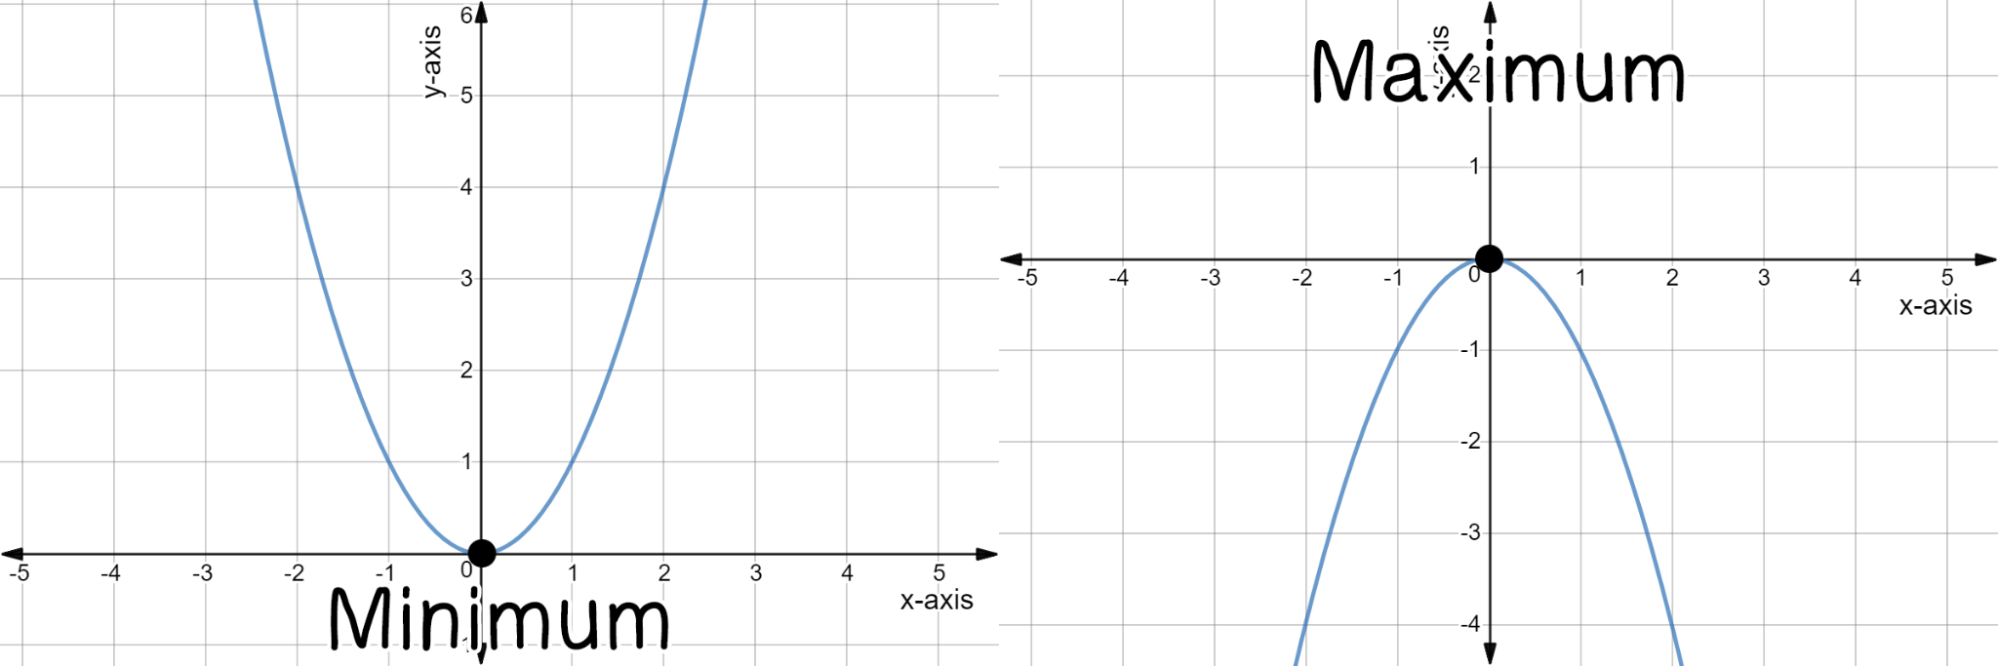
Projectile Trajectories are Parabolas
The curved path of a projectile can be modeled with a mathematical function called a parabola (also know as a quadratic function).
Usually, trajectories are negative parabolas.
Negative parabola points down and is modeled by y = - x².
Positive parabola points up and is modeled by y = x².
Parabolas on x-y coordinate system
What variables do y and x represent in this function?

Slide 11
Optional Mathematical Analysis Activity
For an extra 10 points, you may do this optional activity where you will use a mathematical model to analyze your paper rocket’s projectile trajectory.
(Recommended for Algebra students or anyone who likes math!)

Slide 12
Optional Mathematical Analysis Assignment
Open the Geogebra link: https://www.geogebra.org/graphing .
On the top, left side by the “+,” type y = - x^2 to get a negative parabola shaped like your trajectory.
Now add or subtract numbers to this function. What do you see? Try adding the number that makes the parabola the height of your paper rocket’s trajectory. What other changes can you make to the function, while keeping it a quadratic function?
When you get a parabola on Geogebra that is a good model of your paper rocket’s trajectory, copy and paste it into your EDP Report below your graph of the actual trajectory, along with this information:
  The function that Geogebra shows as the one representing your parabola, and an explanation of how you found it.
  Explanation of what variables y and x represent.
  Your analysis of how well the Geogebra parabola matches your actual trajectory.

Slide 13
Closing
What appeared to affect paper rocket performance the most?
Homework: None, but finish your EDP Report by Tuesday night.

