Slide 1
Example of a Lecture-Based Lesson
The following presentation was a lecture to introduce the science concepts of oscillatory and wave motion. This lecture was the first one given in the school year in 8th grade science, though it is suitable for a basic physics class in high school.
  Note how the lecture has exercises where student crews had activities to do. These activities encouraged good crew teamwork.
The assignment for students was to take notes and submit their notes for grading after the lesson—this lesson was an introduction to the skill of note taking.
  I coached students on how to take notes during this lecture.
  I graded their notes using a rubric that I used all year.
Download for free at: https://bryanholmesauthor.wordpress.com/resources-services/

Slide 2
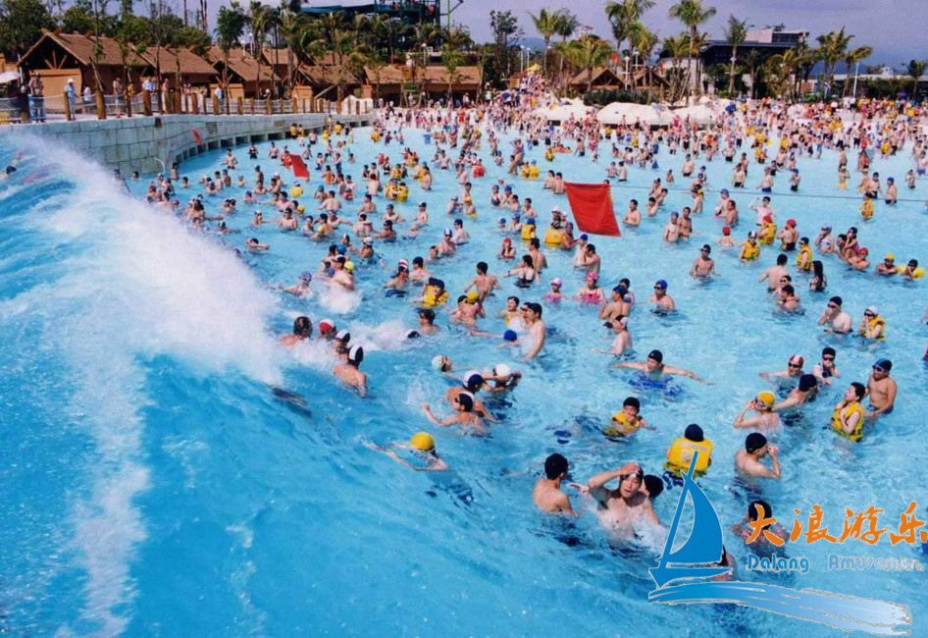
Oscillatory Motion
& Wave Motion
8th Grade Science, Mr. Holmes
Liftoff: Set up your notes for Unit 1, then watch the first 5 minutes of this video and see what creates the waves in a wave pool: https://www.youtube.com/watch?v=Ocl9WS_qav8
Notes:
2

Slide 3
Lesson Overview
Learning Target: I can explain oscillatory motion and relate it to wave motion.
Directions: Today’s lesson is a short lecture to learn about a type of motion called “oscillatory motion,” then to see how that relates to wave motion. During the lesson, please take notes in your notebook. Your assignment at the end of the lesson is to take a photo of your notes and post the photo on Google Classroom. This will count as a Classwork assignment.
NOTE: You also will get a separate homework assignment to review the Safety Contract with your parents/guardians.

Slide 4
Definition of Oscillatory Motion
Objects that go back and forth are “vibrating,” and exhibit “oscillatory motion.”
  “Oscillate” means to swing back and forth.
Some types of oscillatory motion are:
  Things that move back and forth.
  Things that move in a circle or oval.
Notes:
4

Slide 5
Class Exercise #1
With your crew, brainstorm examples of things that go back & forth or around in a circle or oval.
  Make a list and be prepared to share it with the class.
  After you share it, write the list in your notes.
If you are working at home, brainstorm this list by yourself and write it in your notes.
Notes:
5

Slide 6
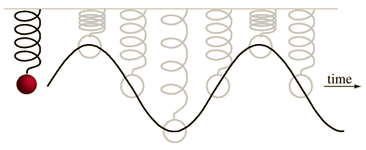
Understanding Oscillatory Motion
Oscillatory motion is where an object moves away from a starting point, then is pulled back by a force, then repeats this motion.
If we watch the object as it moves over time, it looks like it traces a wave in space, as you can see from this ball bouncing up and down on a spring:
What force is pulling the ball down?
What force is pulling the ball back up?

Slide 7
Class Exercise #2
With your crew, brainstorm things you can measure in oscillatory motion.
  Make a list and be prepared to share it with the class.
  Wait to write in your notes until we discuss the measurements as a class.
If you are working at home, brainstorm this list by yourself and write it in your notes.
Notes:
7

Slide 8
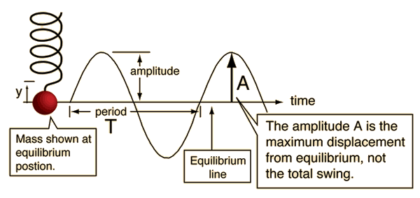
Measuring Oscillatory Motion
Take notes on what you can measure.
The amplitude is how far the ball goes from the equilibrium (center) line up or down, not the total up/down distance.
As an object oscillates, we can measure its amplitude (the distance it is from “equilibrium,” or the center position) and its period (the time it takes to go through one complete oscillation or cycle).

Slide 9
Closing
Oscillatory motion can create waves in various ways.
  This week, we will focus on oscillatory motion by studying, then creating pendulums.
  Next week, we will start to look at wave motion.
Take a photo of your notes and post them on Google Classroom no later than this evening.
Homework: Review Safety Contract with your parents/guardians.

Slide 10
Extra Material
We will cover the following topic if time permits.

Slide 11
Definition of a Wave
A wave is a disturbance that travels through space.
A wave is a movement of energy, not matter.
So how does oscillatory motion relate to waves?
Notes:
11

Slide 12
Relating Oscillatory Motion to Wave Motion
Observe the following animations and describe what you see - what is oscillating and what is traveling as a wave?
https://www.acs.psu.edu/drussell/Demos/waves/wavemotion.html
Waves occur as particles of matter exchange energy as they oscillate - the particles of matter don’t travel through space - they just oscillate - only their energy travels.
Notes:
12

