Slide 1
Example of Engineering Design Project Presentation Assignment
This is a conceptual design challenge assignment where students use the engineering design process up through selecting a design, but where building and testing a prototype is not possible.
Instead of producing an engineering design report, students produced a crew presentation explaining their design choice.
Download for free at: https://bryanholmesauthor.com

Slide 2
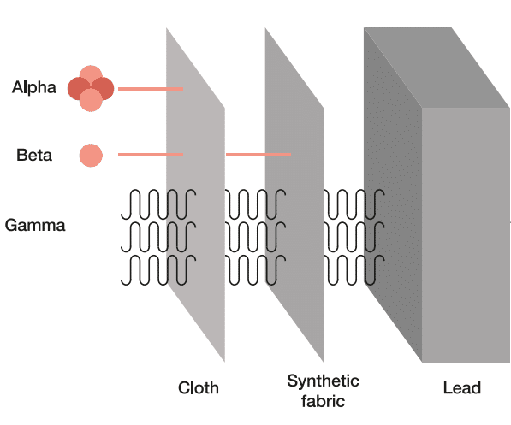
Engineering Design Project (EDP)
Protecting Against Hazardous Radiation for the Mission to Mars
8th Grade Science
Mr. Holmes

Slide 3
Lesson Overview
Learning Target: I can design and present a radiation protection system against harmful radiation for astronauts on Mars.
Directions: Today’s lesson introduces an engineering design project (EDP) that you will work on for the next four days. Today you will get some background information and the design brief, Tuesday you will research and brainstorm to develop a design, Wednesday you will refine your design and build a presentation, and Thursday you will present your design in class. You may work alone or with one other student of your choice. You will submit your presentation on Thursday in Google Classroom when you present it, and I will grade it with the EDP rubric attached in Google Classroom.

Slide 4
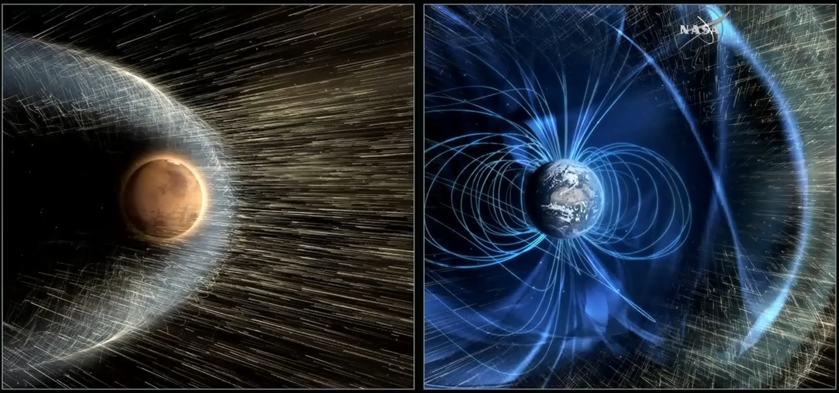
Background Information
Earth, on the right, has a magnetic field and a dense atmosphere that protects it against solar and other radiation. Mars, on the left, is bombarded by radiation with little protection on the surface.

Slide 5
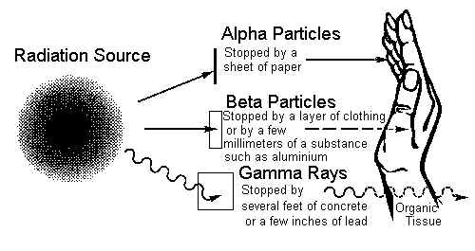
What is Radiation?
Some “radiation” is made up of harmful waves in the EM spectrum, especially Gamma Rays.
Other “radiation” is from harmful high energy particles (Alpha and Beta particles).
NOTE: Alpha, Beta, and Gamma are just the first three letters of the Greek alphabet. Scientists first studying radiation did not know what it was and just named the three types they found as type A (Alpha), type B (Beta), and type C (Gamma). Later, scientists realized what the radiation was, but the names remained as is.

Slide 6
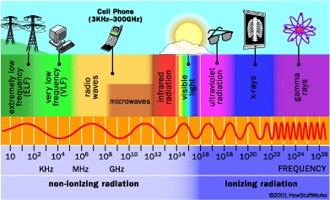
Harmful Waves: Ionizing Radiation in the EM Spectrum, especially Gamma Rays
The ionizing radiation is made up of the higher frequency, higher energy waves that can be harmful.

Slide 7
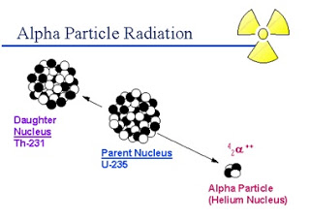
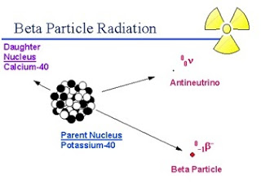
Harmful Particles: Alpha and Beta Radiation
Alpha particles are 2 protons and 2 neutrons bound together.
Beta particles are electrons.
Both are emitted by radioactive decay.
Both can cause damage, but are easily shielded from the human body.

Slide 8
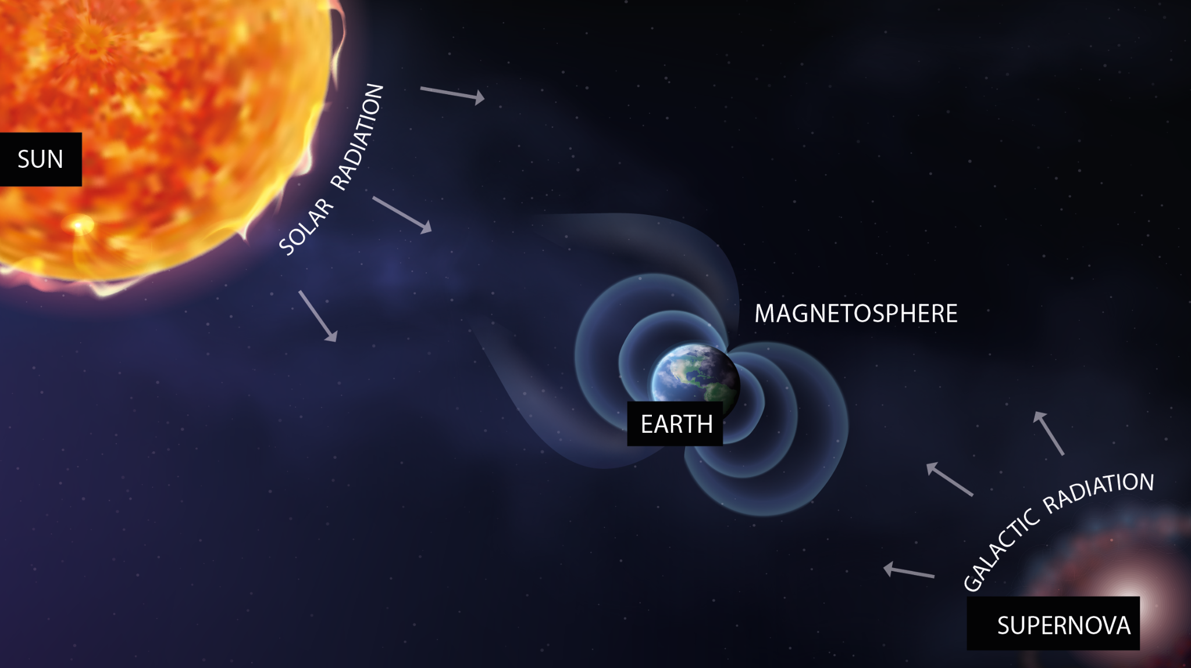
Radiation Sources
For astronauts in space or on Mars, radiation hazards come from the Sun and from stars in our galaxy and other galaxies.
Mars does not have a strong magnetic field or a dense atmosphere like Earth, so it is almost unprotected from solar and galactic radiation.
Earth is Protected from Most Radiation from Space

Slide 9
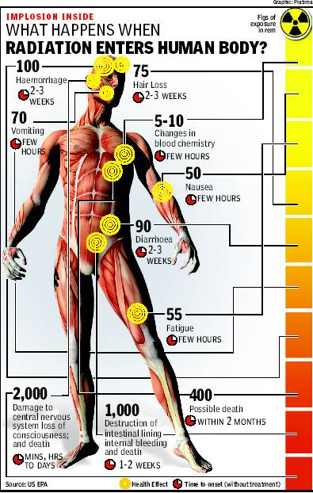
Radiation’s Effect on Human Tissue
Radiation disrupts the atoms that make up cells, leading to dead or mutated cells.
Various side effects can occur.
This picture shows how the human body is affected by various levels of radiation (higher number = higher radiation).

Slide 10
Summary
Aircrew and astronauts can be exposed to more radiation than humans on Earth.
Any mission to Mars will require special protection against radiation for the astronauts living there.
NASA has identified the radiation risks in space: https://www.nasa.gov/missions/analog-field-testing/why-space-radiation-matters/

Slide 11
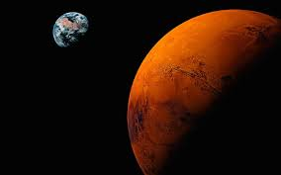
Engineering Design Project
Protecting Against Hazardous Radiation for the Mission to Mars

Slide 12
Design Brief
Problem: NASA and some commercial companies plan to send humans to Mars within the next couple decades, but the Mars environment is hazardous, especially due to radiation.
Proposed solution: Design and present a safe living space on Mars where astronauts will be protected against the harmful effects of radiation.
Criteria:
  Plan on the living space having 20 astronauts living there for six months.
  The living space may be made up of one or more buildings or structures, and it may be below, on, or above the surface of Mars.
  Your design must clearly show how the living space is protected against radiation.
  Because the astronauts will be there six months, your design must also include:
    Designated areas for working, recreation, eating, and sleeping.
    Storage space for equipment and supplies, including food.
  See the next slide for detailed requirements for presenting your design.
Constraints:
  It is unrealistic to bring large amounts of building materials from Earth to Mars, so only 10% or less of the living space building materials may be brought from Earth; the other 90% of building materials must be made from materials already on Mars (rocks, dirt, ice, etc.). Your design must clearly show these percentages.
  You may work alone or with a partner of your choice - this is not a crew project.
  Due date: Present your design in a Google Slides presentation to the class on Thursday, 10/21/2021.

Slide 13
Requirements for Presenting
Your Design
Your design of a living space on Mars can be presented in various ways, but no matter what, it must clearly show:
  The locations of each major part of the living space, such as on the surface, below the surface, or above the surface of Mars, and any special geographic location, such as near the equator or pole.
  The materials used to construct it, including what was brought from Earth and what was used on Mars.
  The basic dimensions (length, width, height) of each major part of the living space in meters--these dimensions will be estimates, not exact figures.
  Cite the sources you used on a slide.
Acceptable ways to present your design are:
  A drawing done in Google Slides using the drawing tools available.
  A drawing of the design on graph paper that is scanned and put into Google Slides.
  A physical model that you build of cardboard, clay, Legos, or any other materials - you can bring the model into class, and you can put photos of it in your Google Slides.
  A model of your living space made using Minecraft, a CAD program, or some other design program.

Slide 14
Timeline for Doing Assignment
Here is the timeline to complete this assignment by the deadline:
  Finish research and brainstorming by the end of class on Tuesday, 10/19/2021.
  Finish your design and Google Slides by the end of class on Wednesday, 10/20/2021.
  Be ready to present your design (Google Slides presentation) at the start of class on Thursday, 10/21/2021.
Students who are absent on any of these days are still expected to have their design completed and their Google Slides submitted on Google Classroom by Thursday, 10/21/2021.

Slide 15
Suggested Resources
NASA article on protecting humans on Mars: https://www.nasa.gov/feature/goddard/real-martians-how-to-protect-astronauts-from-space-radiation-on-mars
Phys.org article on how bad the radiation is on Mars: https://phys.org/news/2016-11-bad-mars.html
NASA Z Shielding material (video): https://www.youtube.com/watch?v=oHA8j5bpFcU
Phys.org article on using Mars “regolith” (loose rocky soil on surface of a planet) as a radiation shielding material: https://phys.org/news/2012-09-regolith-humans-mars.html
Spacearchitect.org article and video proposing way to 3D print a Martian colony using regolith (Martian soil): https://spacearchitect.org/portfolio-item/3d-printed-mars-habitat-3rd-phase-of-nasas-centennial-challenge/

Slide 16
Closing
What questions do you have to pursue in research?
This assignment counts as an EDP (40 points). See Google Classroom for the rubric.
Homework: Nothing assigned, but this project will need to be done in and outside of class for you to finish on time.

