Slide 1
Example of Research Project Assignment
This assignment was my way of flipping a lecture into a more student-centered activity.
  Rather than my lecturing and covering all the topics, I gave an introductory lecture of about 20 minutes, then let each student group (crew) pick a topic, research it, then present their findings to the class—the total time for this assignment was two class days.
  Students took notes as each crew presented.
I organized this assignment by having a slide for each class period showing which crew picked which topic.
Download for free at: https://bryanholmesauthor.com

Slide 2
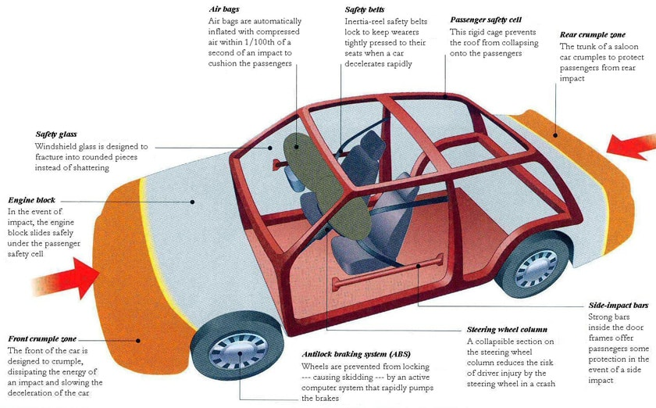
Research Project
Car and Highway Safety Features that Reduce the Effects of a Collision
8th Grade Science
Mr. Holmes

Slide 3
Lesson Overview
Learning Target: I can research and present a topic on how different car and highway safety features have reduced the impact of car collisions.
Directions: This lesson is a research project assignment. You and your crew will pick a topic and research it today, then present it in class tomorrow. We will go through this presentation to prepare you, then you will get most of the period to do your research. You will be graded as a crew using the rubric posted in Google Classroom.
REMOTE STUDENTS: Pick two of the safety features listed and write a one-page paper summarizing how they work and how they reduce force and energy in a collision.

Slide 4
Danger of Car Collisions
38,680 lives were lost in 2020 on U.S. roads, and most of these deaths were due to collisions.
  Cars colliding with other cars.
  Cars colliding with other objects, such as highway features, buildings, trees, etc.
What kills people in car accidents is the excessive force and energy of the collision.
The National Highway Traffic Safety Administration (NHSTA) is the government agency responsible for tracking this information and investigating road accidents.

Slide 5
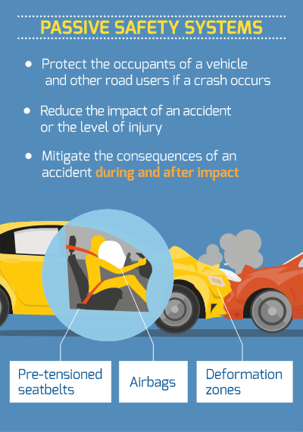
Progress in Safety Features
Car and highway safety features have improved over the years, and far fewer people are injured or killed, compared to the past.
  According to NHSTA, cars today have a 56% lower risk of causing a deadly accident compared to cars in the 1950’s.
These safety features reduce the force and energy of the collision on people’s bodies.
We watched this video at the start of this unit:
https://www.youtube.com/watch?v=joMK1WZjP7g

Slide 6
Research Project Assignment
For this assignment, each crew must choose one of the following options, research it, then present your findings to the class. There is a suggested source under each topic.
  Safety belts
    https://www.nhtsa.gov/risky-driving/seat-belts
  Airbags
    https://www.nhtsa.gov/equipment/air-bags
  Crumple zones
    https://auto.howstuffworks.com/car-driving-safety/safety-regulatory-devices/crumple-zone.htm
  Runaway ramps
    https://www.dot.nv.gov/safety/roadway-safety-improvements/truck-escape-ramps
  Highway collapsible barriers (filled with sand or water)
    https://www.youtube.com/watch?v=bhifYpN21Dg
  Breakaway signs and posts
    https://designovations.com/nchrp-report/

Slide 7
Research Project Assignment - Period 1
Crew topics:
  Crumple zones
  Breakaway signs & collapsible
barriers
  Runaway ramps
  Airbags
  Seat belts
  n/a
You will have today to do your research and to build a Google Slides that your crew presents in class tomorrow.
Presentations will be graded using the rubric posted in Google Classroom.
Your crew’s presentation should include:
What the safety feature is and what it does.
How the safety feature reduces the force and energy of a collision on the driver/passengers.
Sources you used.

Slide 8
Research Project Assignment - Period 2
Crew topics:
  Safety belts
  Collapsible barriers
  Airbags
  Runaway ramps
  Crumple zones
  n/a
You will have today to do your research and to build a Google Slides that your crew presents in class tomorrow.
Presentations will be graded using the rubric posted in Google Classroom.
Your crew’s presentation should include:
What the safety feature is and what it does.
How the safety feature reduces the force and energy of a collision on the driver/passengers.
Sources you used.

Slide 9
Research Project Assignment - Period 5
Crew topics:
  Collapsible barriers
  Crumple zones
  Breakaway sign posts
  Air bags
  Runaway ramps
  Safety belts
You will have today to do your research and to build a Google Slides that your crew presents in class tomorrow.
Presentations will be graded using the rubric posted in Google Classroom.
Your crew’s presentation should include:
What the safety feature is and what it does.
How the safety feature reduces the force and energy of a collision on the driver/passengers.
Sources you used.

Slide 10
Research Project Assignment - Period 6
Crew topics:
  Safety belts
  Breakaway signs
  Crumple zones
  Runaway ramps
  Air bags
  n/a
You will have today to do your research and to build a Google Slides that your crew presents in class tomorrow.
Presentations will be graded using the rubric posted in Google Classroom.
Your crew’s presentation should include:
What the safety feature is and what it does.
How the safety feature reduces the force and energy of a collision on the driver/passengers.
Sources you used.

Slide 11
Research Project Assignment - Period 8
Crew topics:
  Safety belts
  Crumple zones
  Air bags
  Compressible barriers
  Runaway ramps
You will have today to do your research and to build a Google Slides that your crew presents in class tomorrow.
Presentations will be graded using the rubric posted in Google Classroom.
Your crew’s presentation should include:
What the safety feature is and what it does.
How the safety feature reduces the force and energy of a collision on the driver/passengers.
Sources you used.

Slide 12
Closing
What have you learned so far about these safety features? What surprised you?
No homework, but be ready to present tomorrow about 15 minutes after class begins.

